Slide 1
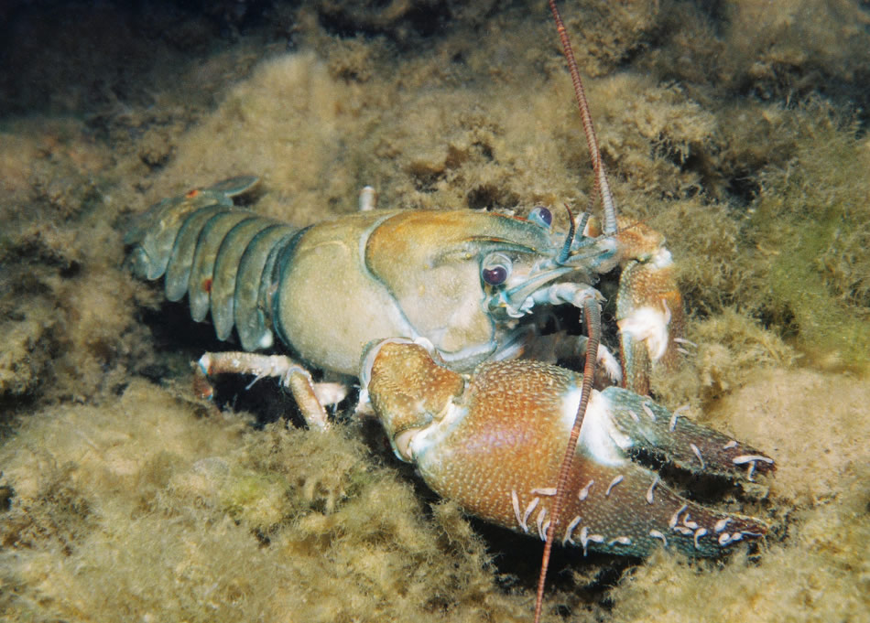
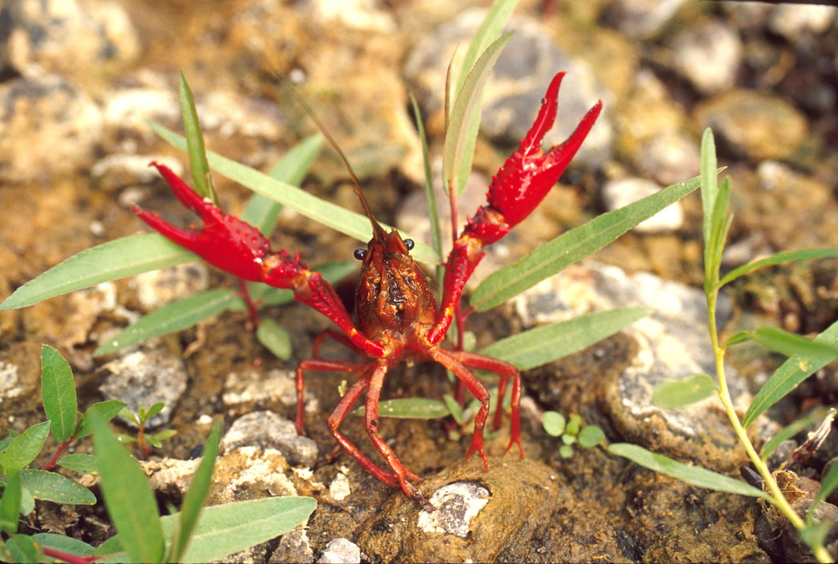
Native + Invasive Crayfish
Notes:
How do we identify native and invasive crayfish? And do they impact freshwater ecosystems?
Signal crayfish image (on left) by Roger Tabor (U.S. Fish and Wildlife Service): https://www.flickr.com/photos/usfwspacific/6093365240 (licensed for noncommercial reuse)
Red swamp crayfish image (on right) source: National Park Service: https://www.flickr.com/photos/santamonicamtns/11954193476 (licensed for noncommercial reuse)

Slide 2
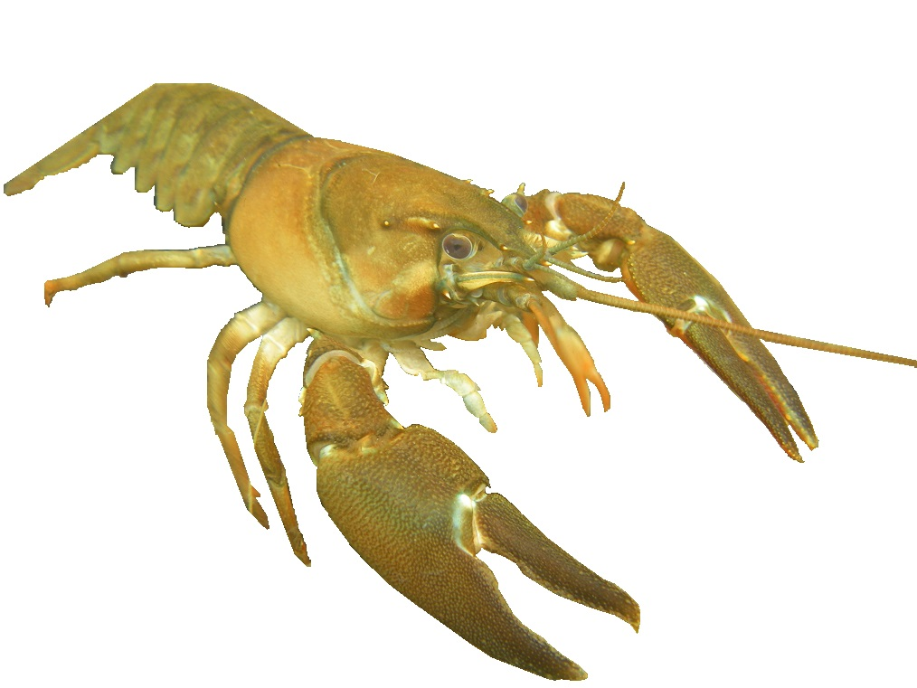
Signal Crayfish Pacifastacus leniusculus
Notes:
Signal crayfish are native to the Pacific Northwest. “This species can be identified by its uniform brownish coloration, white or light coloration of the claw joint, and the smooth surface of its carapace and claws compared to that of nonnative species”. Description from WA Dept. of Fish & Wildlife
Signal crayfish image by Jeff Benca; used by permission

Slide 3
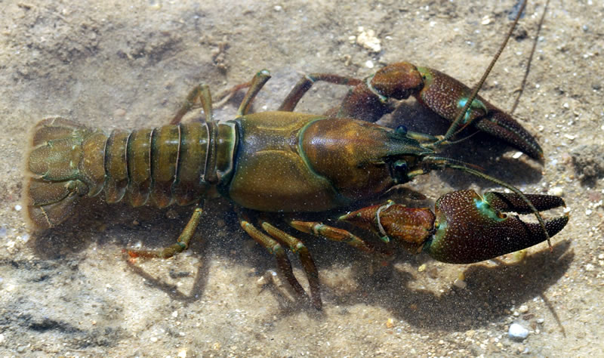
Signal Crayfish Pacifastacus leniusculus
Notes:
A darker brown signal crayfish. They can also be more red. “Native crayfish are the only crayfish that may be removed from the vicinity of the waterbody alive” (WA Dept. of Fish & Wildlife). Quote and image from: https://wdfw.wa.gov/fishing/washington/Species/6742/

Slide 4
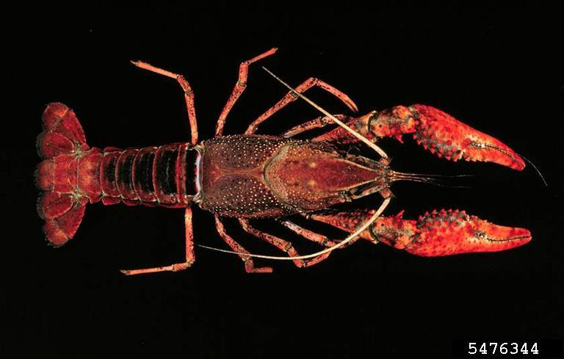
Red Swamp Crayfish Procambarus clarkii
Notes:
● Dark red as adults, sometimes bordering on black (or occasionally blue)
● Adults range from 2-5 inches (5-13 cm) long
● Longer, narrower claws than native signal crayfish
● Covered with red, white, or black tubercules (bumps)
● “Salt and pepper” spotting pattern over carapace in black, grey, white or red
● Black “V” pattern on dorsal (back) side of abdomen (tail)
● Juveniles gray or brown without spots; body shape and pattern similar to adults, although juveniles sometimes have dark wavy lines
Description source: Olden, J.D. Brief Guide to Crayfish Identification in the Pacific Northwest: https://wdfw.wa.gov/fishing/shellfish/crayfish/crayfish_id_guide.pdf
Image source: U.S. Fish & Wildlife Service: https://www.flickr.com/photos/usfwspacific/8027151587

Slide 5
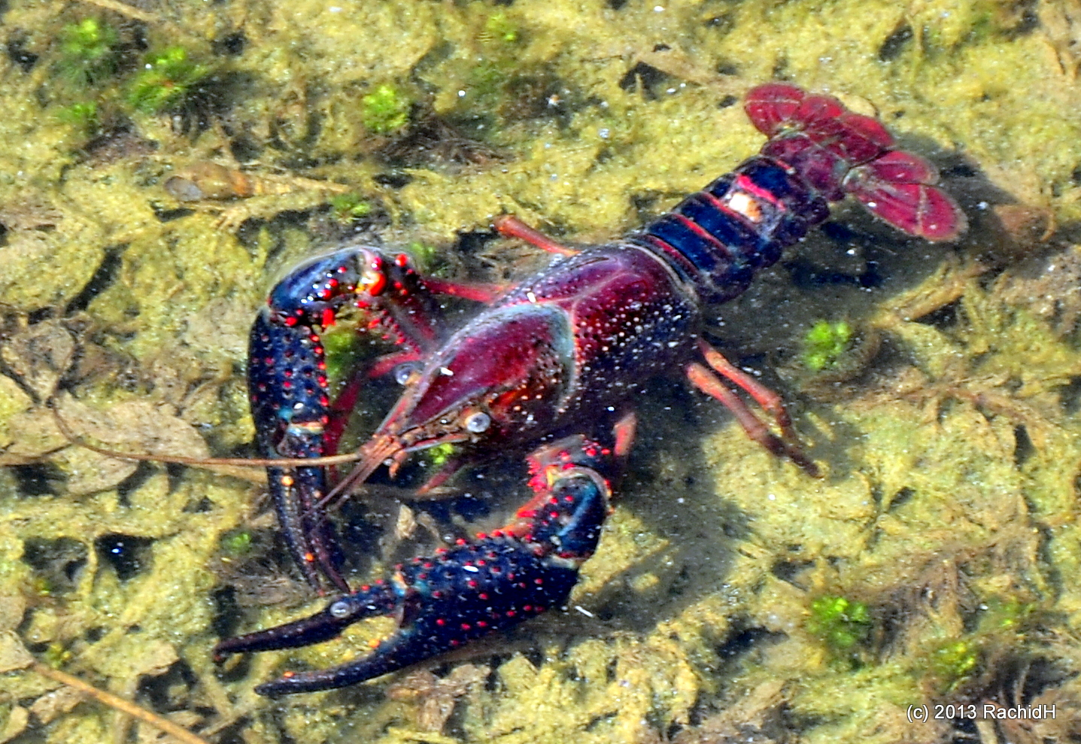
Red Swamp Crayfish Procambarus clarkii
Notes:
● Native of Mississippi river drainage and coast of Gulf of Mexico
● Aggressively compete with native crayfish for food and habitat
Description source: Michigan Invasive Species: https://www.michigan.gov/invasives/0,5664,7-324-68002_74188-367863--,00.html
Image source: Rachid H: https://www.flickr.com/photos/rachidh/10349907123/

Slide 6
Red Swamp Crayfish Procambarus clarkii
Notes:
● Reduce habitat for many amphibians, invertebrates, and juvenile fish
● Burrowing and foraging behavior can also lead to summer cyanobacteria blooms and eutrophic (less oxygen) conditions
Description source: Michigan Invasive Species: https://www.michigan.gov/invasives/0,5664,7-324-68002_74188-367863--,00.html
Image Source: National Park Service: https://www.flickr.com/photos/santamonicamtns/11954193476

Slide 7
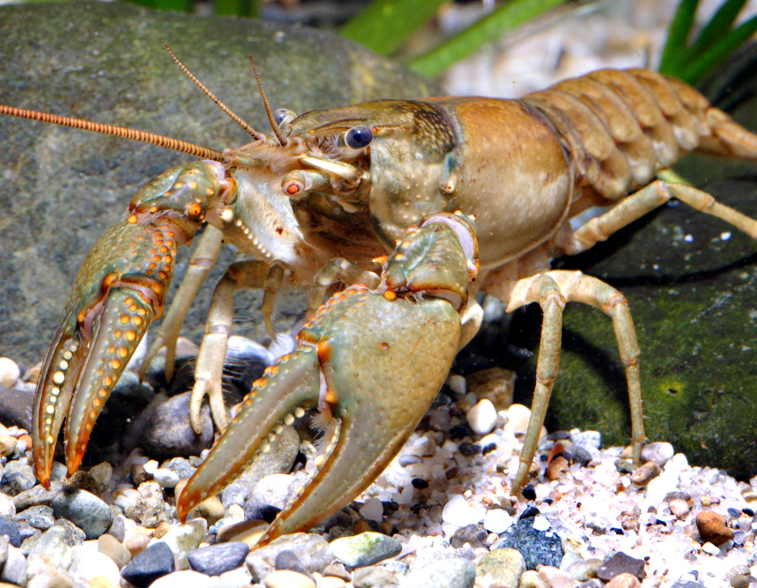
Northern Crayfish Orconectes virilis
Notes:
● Medium to large crayfish; grows to 5 inches (13 cm), or sometimes more
● Olive-brown or reddish-brown body, dappled with dark brown
● Large claws with large, flattened tubercules (bumps) on the medial sides (those closest to the head)
● Pincers are green or greenish-blue with orange or orange-red tips
● Rostrum has notches or spines near tip
● Prefer permanent, well-oxygenated freshwater ecosystems with substrates of silt to cobble such as rivers, streams, lakes, and ponds
● Found at depths ranging from a few inches to 100 feet (30 meters) of water
Description sources: Missouri Dept. of Conservation site listed below and: Olden, J.D. Brief Guide to Crayfish Identification in the Pacific Northwest: https://wdfw.wa.gov/fishing/shellfish/crayfish/crayfish_id_guide.pdf
Image source: Missouri Dept. of Conservation: https://nature.mdc.mo.gov/discover-nature/field-guide/virile-crayfish-northern-crayfish

Slide 8
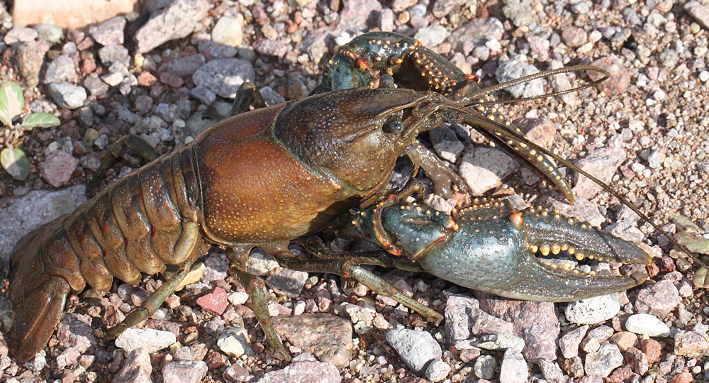
Northern Crayfish Orconectes virilis
Notes:
● Abdominal (tail) segments have dark brown blotches; most visible in juveniles
Image source: Alan Schmierer: https://www.flickr.com/photos/sloalan/7670748928

Slide 9
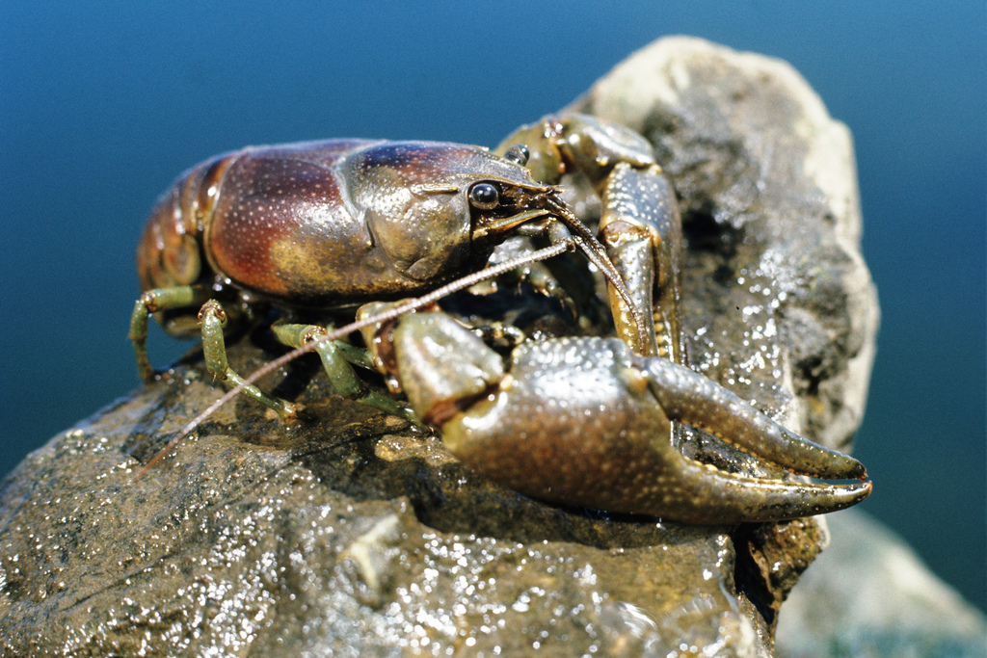
Rusty Crayfish Orconectes rusticus
Notes:
● Dark, rusty spots on each side of their carapace near joint with abdomen
● Maximum length: 4 inches (10 cm)
● Claws are proportionally larger than other crayfish species
● Claws often have black tips and are usually smoother than those of northern crayfish, although may still have tubercules (bumps)
Description sources: ● Rusty Crayfish: A Nasty Invader. Minnesota Sea Grant: http://www.seagrant.umn.edu/ais/rustycrayfish_invader
● Olden, J.D. Brief Guide to Crayfish Identification in the Pacific Northwest: https://wdfw.wa.gov/fishing/shellfish/crayfish/crayfish_id_guide.pdf
Image source: Wisconsin Dept. of Fish & Wildlife: https://www.flickr.com/photos/widnr/6506232505

Slide 10
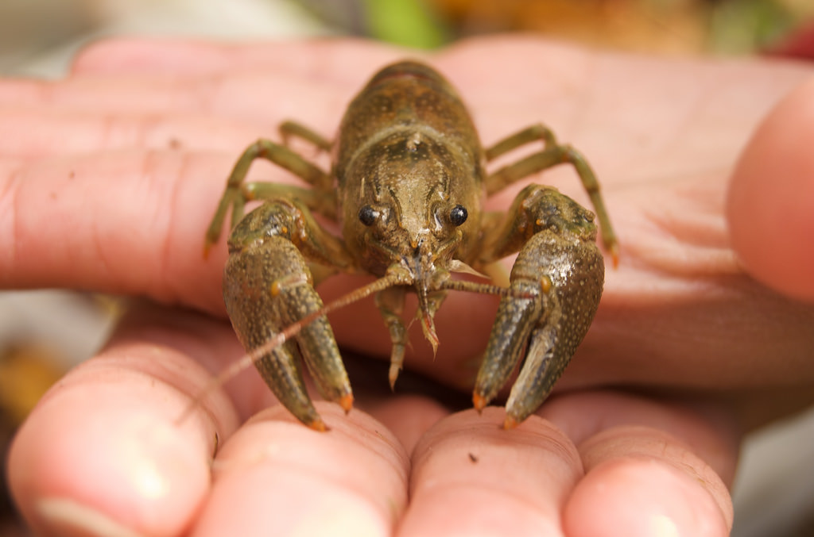
Rusty Crayfish Orconectes rusticus
Notes:
Image source: Ashour Rehana: https://www.flickr.com/photos/arehana/2967950426

Slide 11
What problems do invasive crayfish cause?
Outcompete native species for food + habitat
Eat too many fish + amphibian eggs
Burrowing and foraging behavior can lead to cyanobacteria blooms; less oxygen
Notes:
● Native crayfish and other macroinvertebrates, as well as native amphibians, reptiles, and fish impacted

Slide 12
Native + Invasive Crayfish

